Slide 1

03.
Software Requirement Specification

Slide 2

Software Requirement Specification
Software requirement specification
Functional requirement
Non-functional requirement
Entity diagram

Slide 3

3.1
Software requirement specification

Slide 4

SYSTEM ACTORS
GUEST
USER
MANAGER
The person who does’t have an account and not log in to the system
The person who has an account and logged in
The person who manages the whole system, users, posts, reports, balance and recommendation data

Slide 5
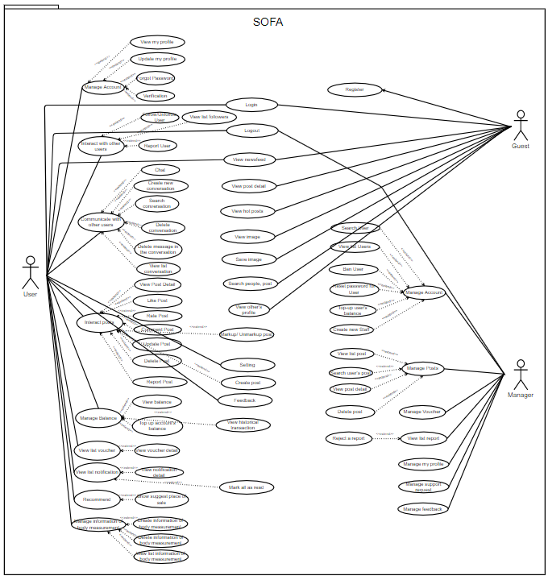
System Usecase Diagram

Slide 6
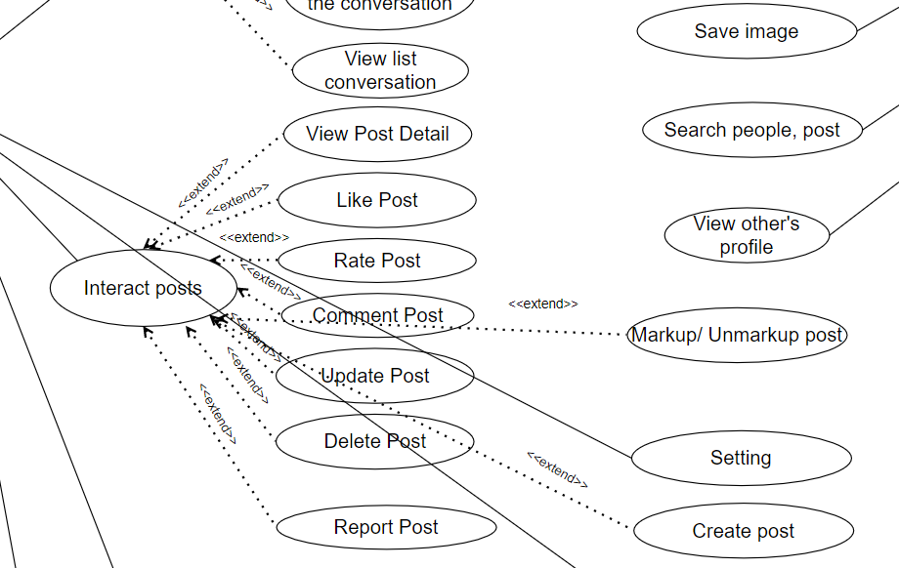
System Usecase Diagram
System Usecase Diagram

Slide 7

3.2
Functional Requirement

Slide 8
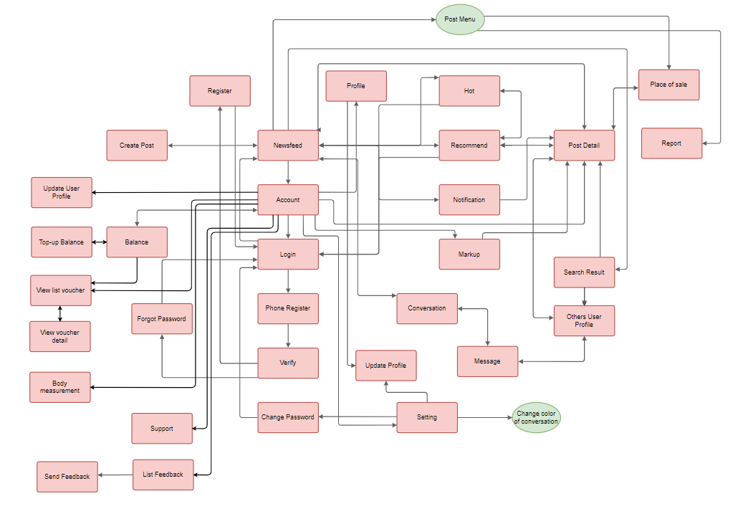
Screen Flow (User)

Slide 9
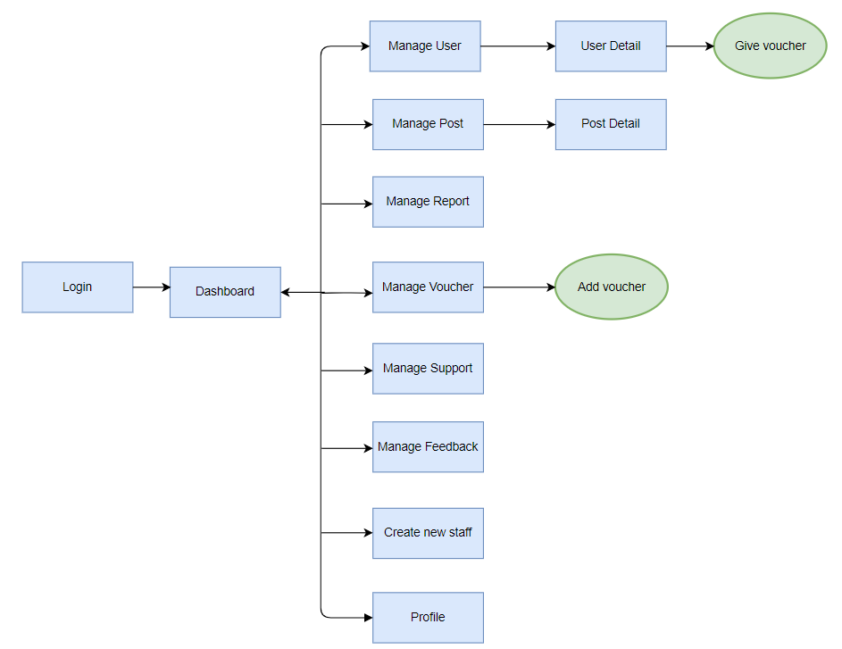
Screen Flow (Manager)

Slide 10

3.2
Non-functional Requirement

Slide 11
Non-functional Requirement
Usability
Peformance
Maintainability
Reliability
Security

Slide 12
Non-functional Requirement
Usability
Peformance
Maintainability
Reliability
Security

Slide 13

Usability
- The application has a stylish interface with the ocean blue main color - The system has a friendly and good-looking GUI - The interface of main functions is inherited and developed from previous successful systems such as Facebook, Instagram, ...

Slide 14
Non-functional Requirement
Usability
Peformance
Maintainability
Reliability
Security

Slide 15
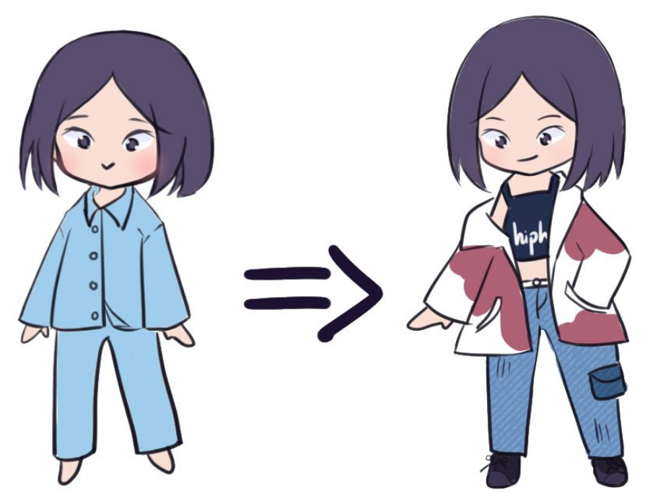
Reliability
GUEST
2
3
1
The system complies with business rules
The application is guaranteed to run smoothly, without errors, stable and safe
The display of personal information such as email, phone number, measurements, ... will be private

Slide 16
Non-functional Requirement
Usability
Peformance
Maintainability
Reliability
Security

Slide 17

GUIDING PRINCIPLES
- Two functions (Message and Notification) are real-time updates. When a new message or notification appears, users will receive it immediately
- The system allows 10000 users at a time

Slide 18
Non-functional Requirement
Usability
Peformance
Maintainability
Reliability
Security

Slide 19

Security
- Each email, phone number is only validated for one account. Users can use a Google account to log in
- The system must use HTTPS to encrypt the information transferred between clients and servers.
- Use the JWT Bearer Token to authenticate users
- Before uploading a file to the system, the file will be verified for the correct file format

Slide 20
Non-functional Requirement
Usability
Peformance
Maintainability
Reliability
Security

Slide 21

Maintainability
- We can easily maintain our application because of the separation of concern - At the same time, we can split many developers' work at a time. It will not affect one developer's work to another developer's work.

Slide 22
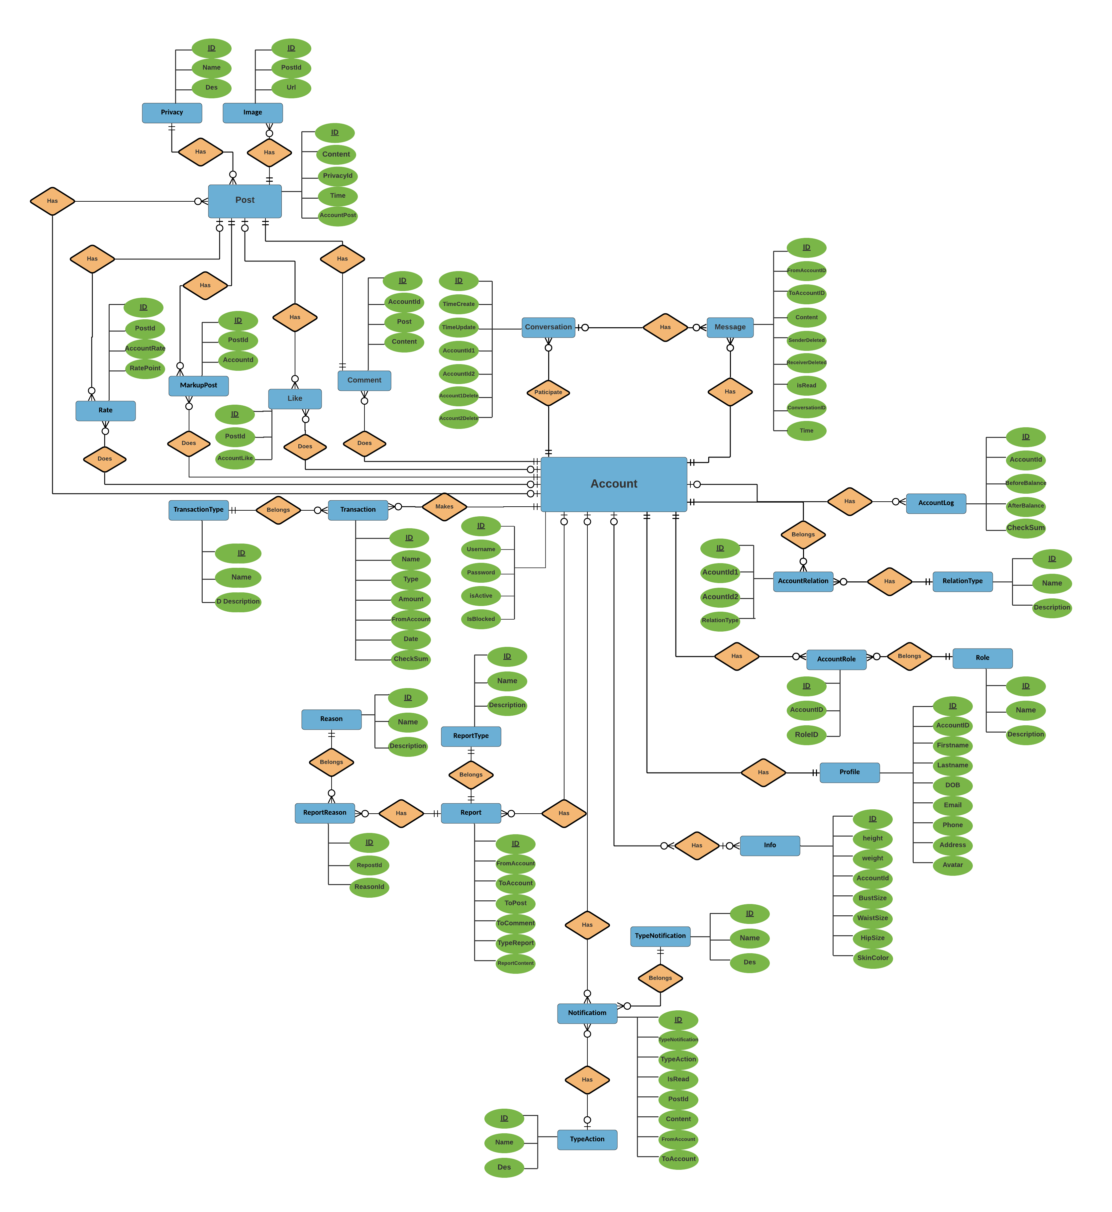
Entity relation diagram

Slide 23
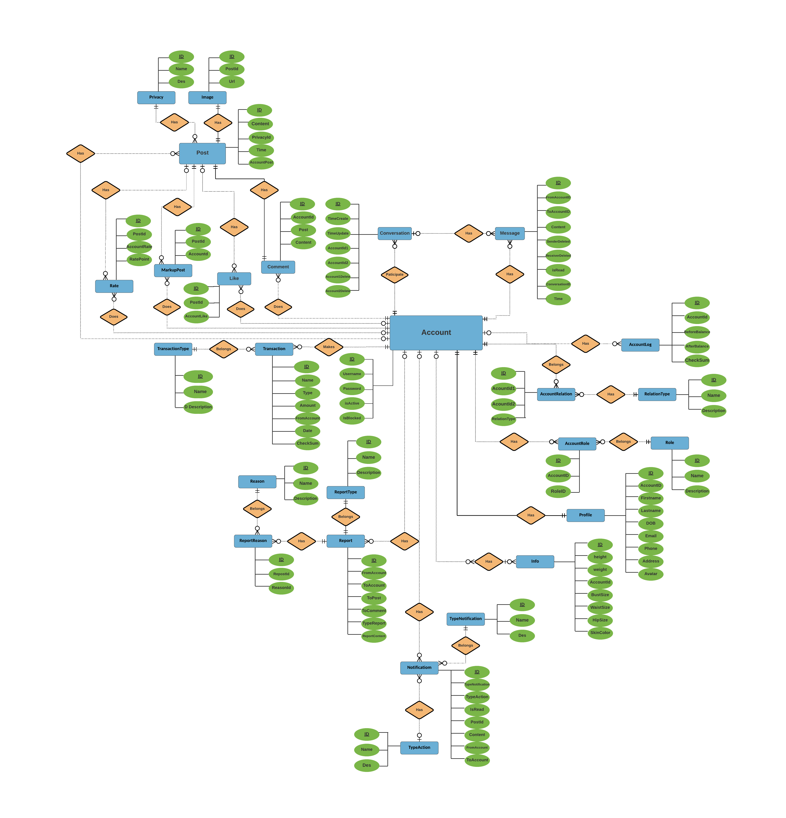
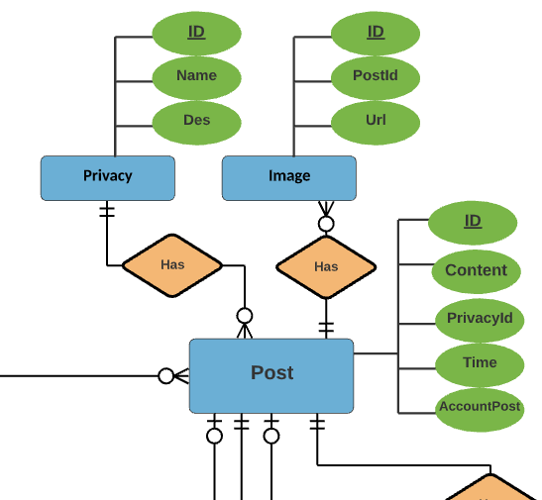
Entity relation diagram
Entity relation diagram

Slide 24
04.
Software Design

Slide 25
Software Design
1
2
3
4
System Architecture Design
Software Architecture Design
Component Diagram
Class Diagram
5
6
7
Sequence Diagram
Description of System Interface
User Interface Design

Slide 26
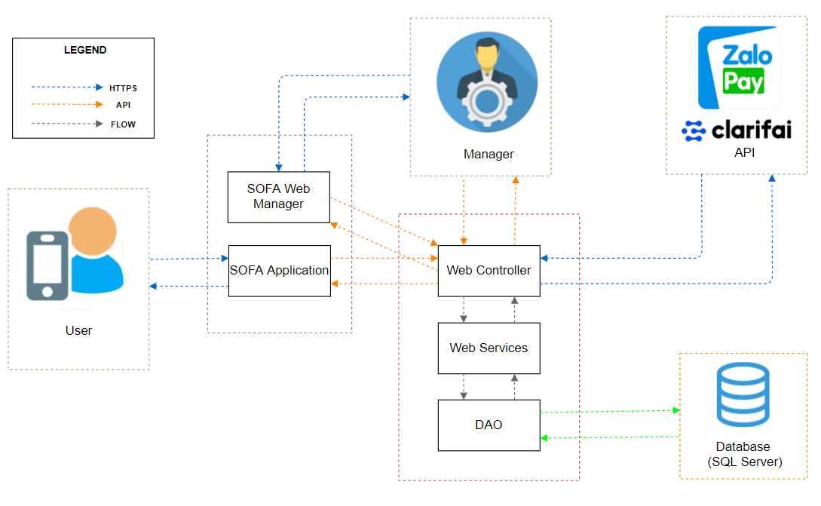
System Architecture Design

Slide 27
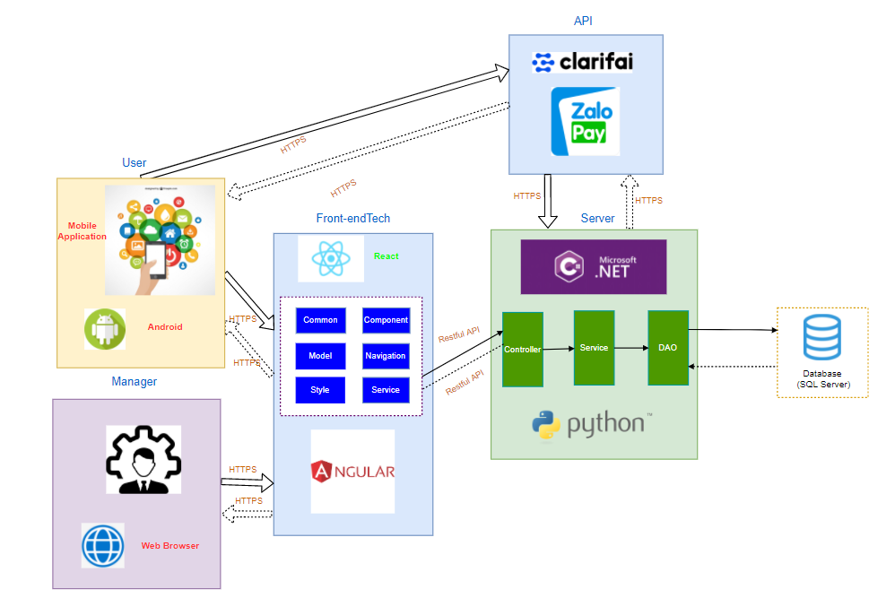
Software Architecture Design

Slide 28

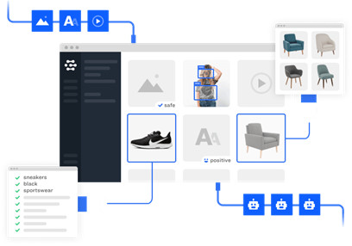
System Interface

Slide 29
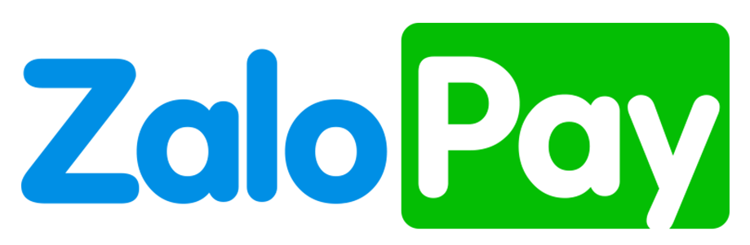
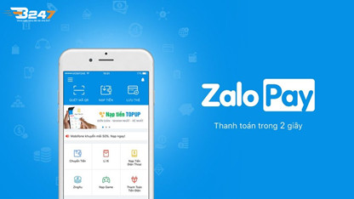
System Interface

Slide 30

System Interface

Slide 31
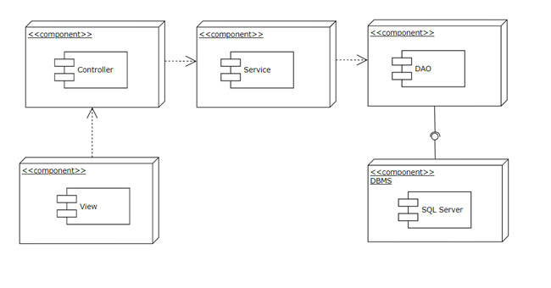
Component Diagram

Slide 32
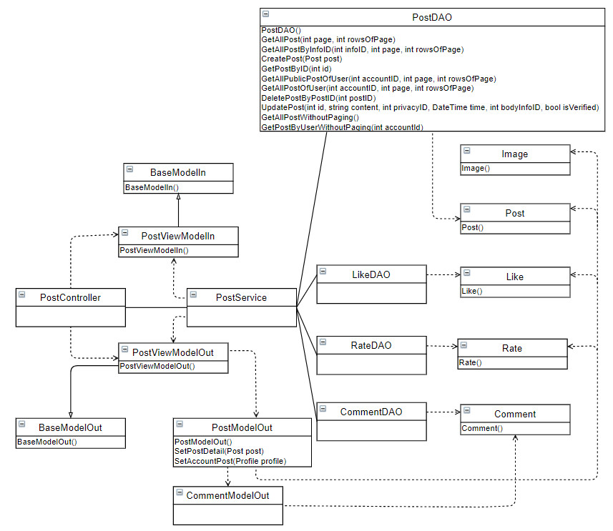
Class Diagram
Post class diagram

Slide 33
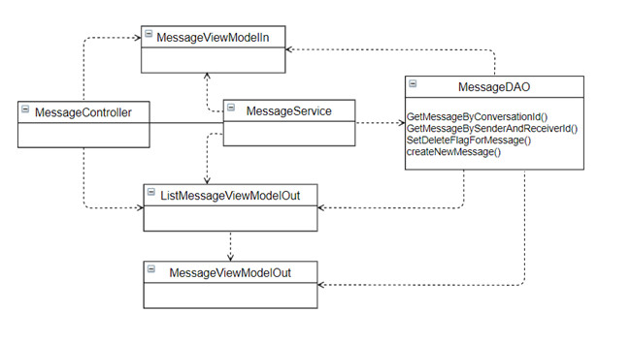
Class Diagram
Message class diagram

Slide 34
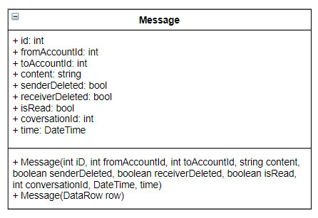
Class Diagram
Message model

Slide 35
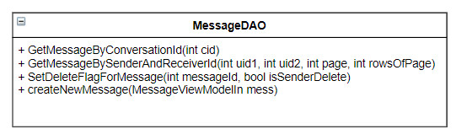
Class Diagram
Message DAO

Slide 36
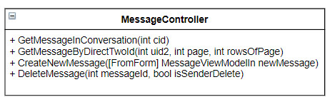
Class Diagram
Message Controller

Slide 37
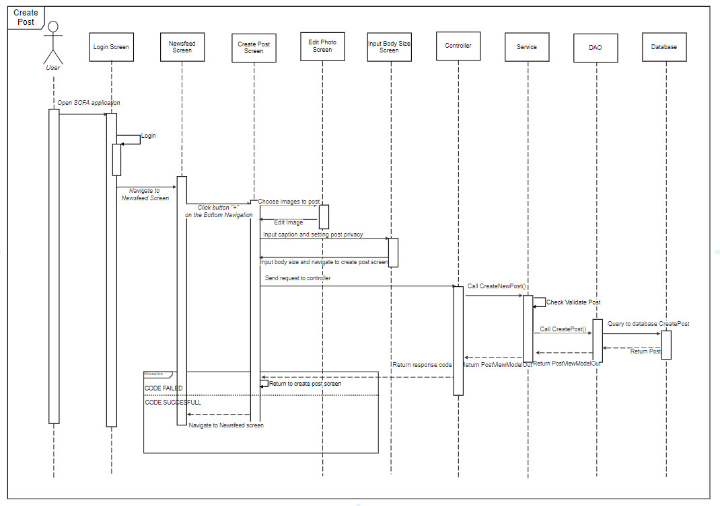
Sequence Diagram

Slide 38
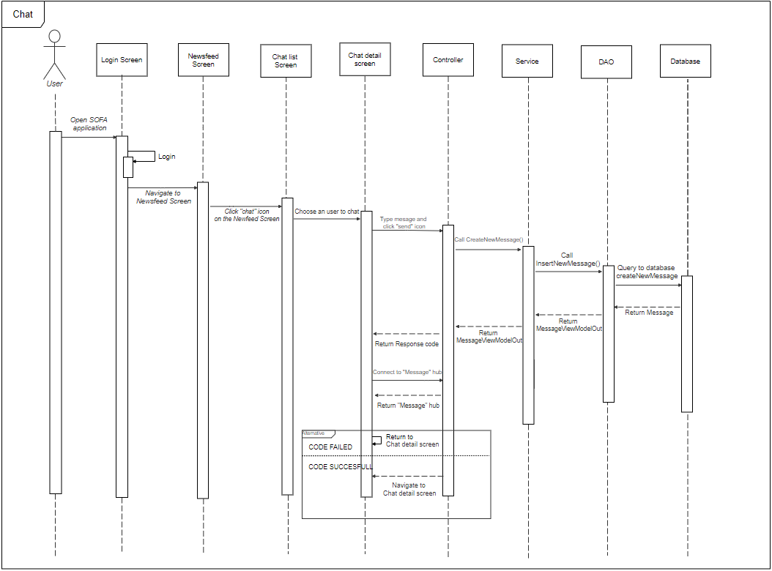
Sequence Diagram

Slide 39
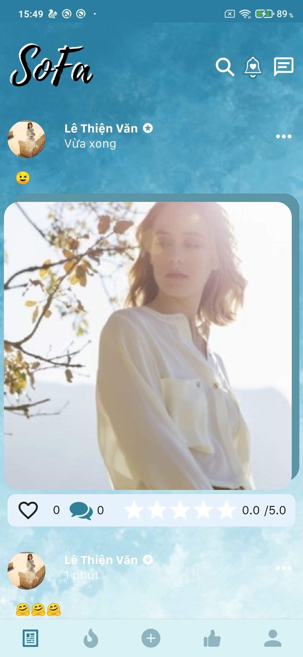
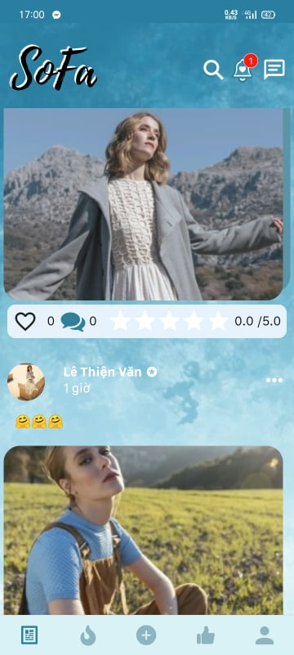
User Interface Design
Newfeed Screen

Slide 40
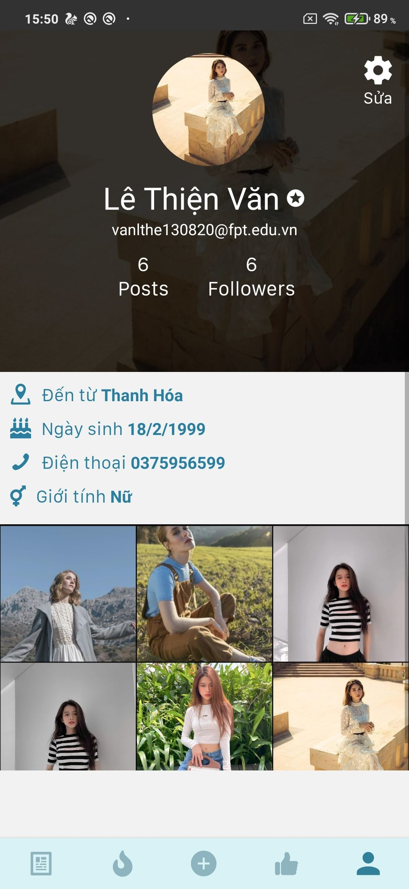
Profile Screen
User Interface Design

Slide 41
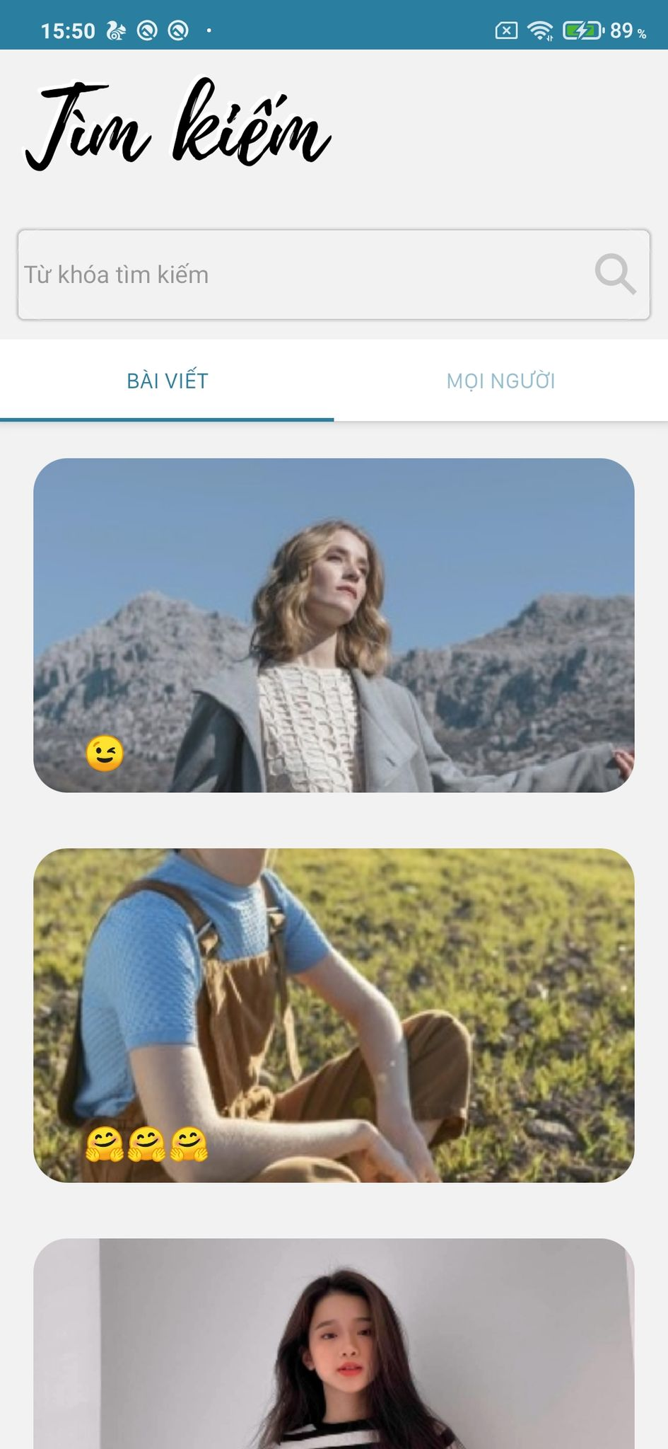
Search Screen

Slide 42
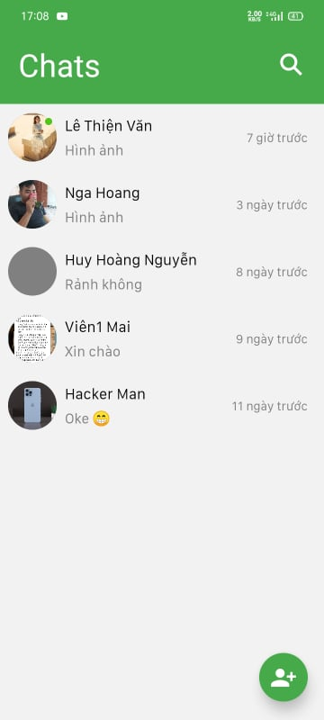
Chat Screen
User Interface Design

Slide 43
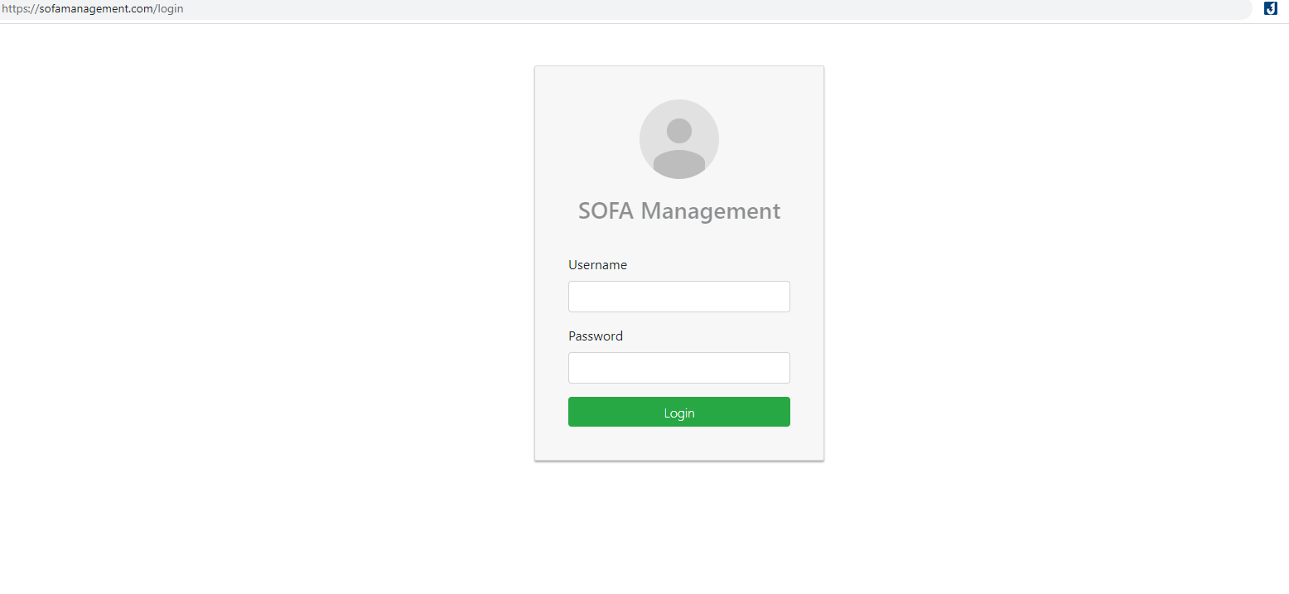
Manager – Login screen

Slide 44
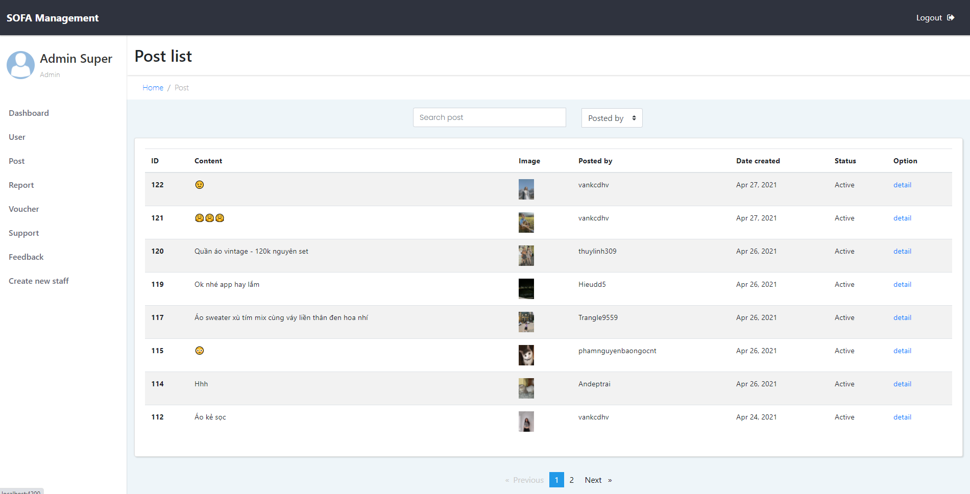
Manager – Post list screen

Slide 45
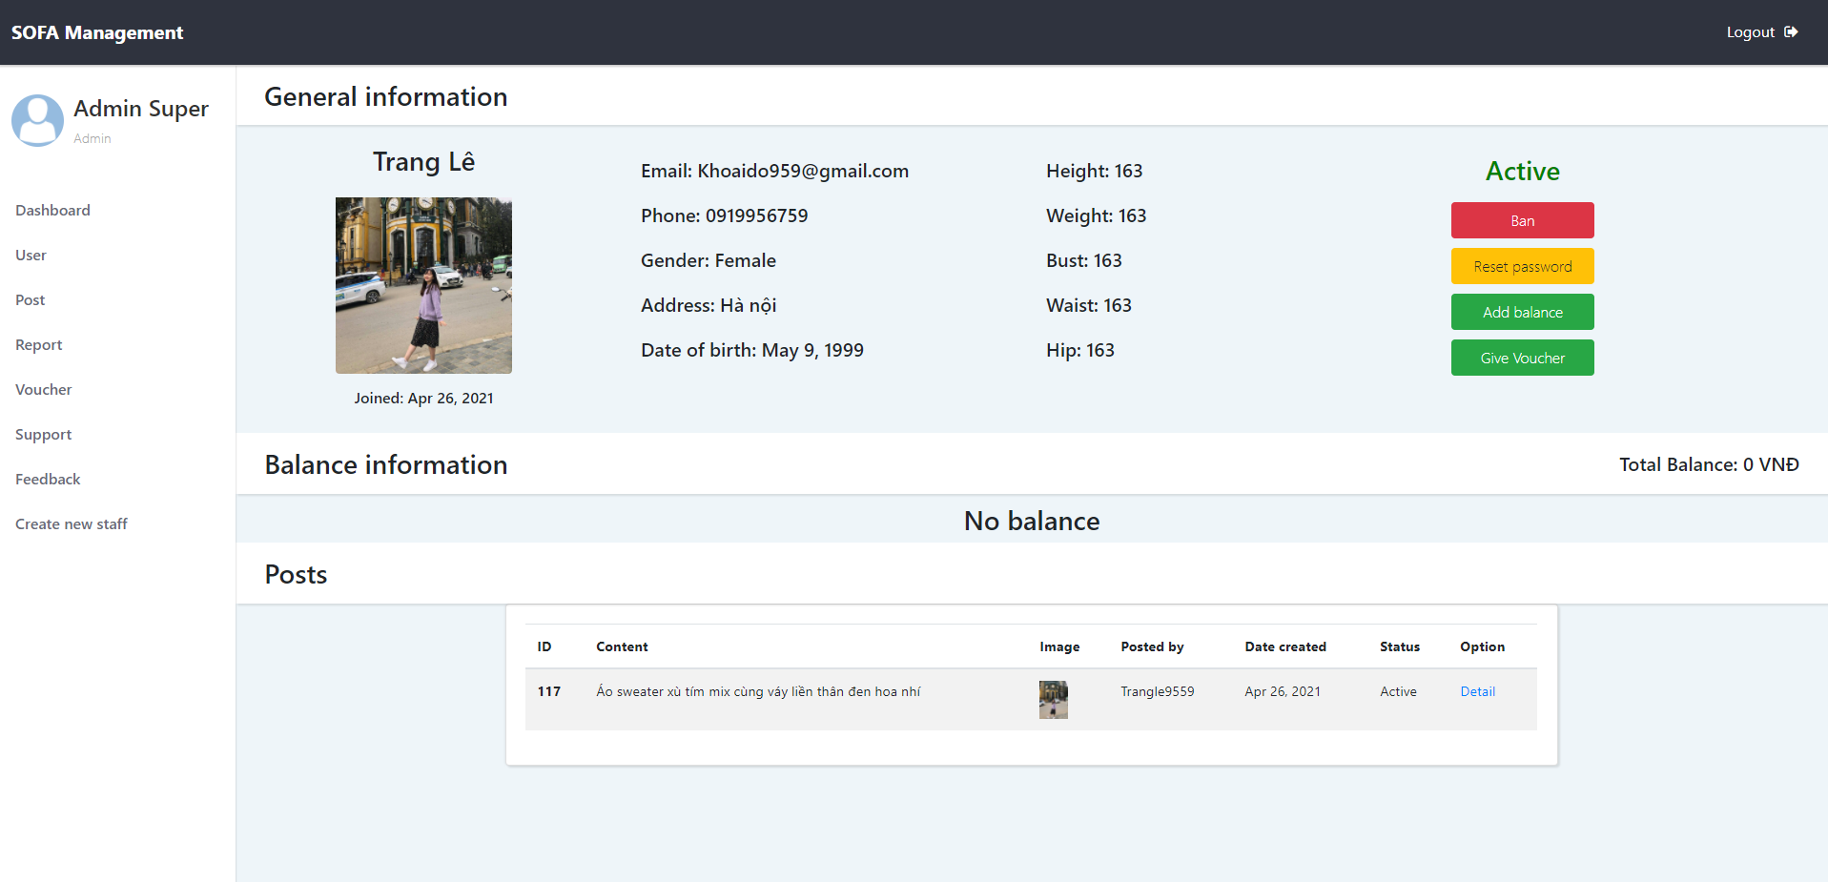
Manager – User detail screen

Slide 46
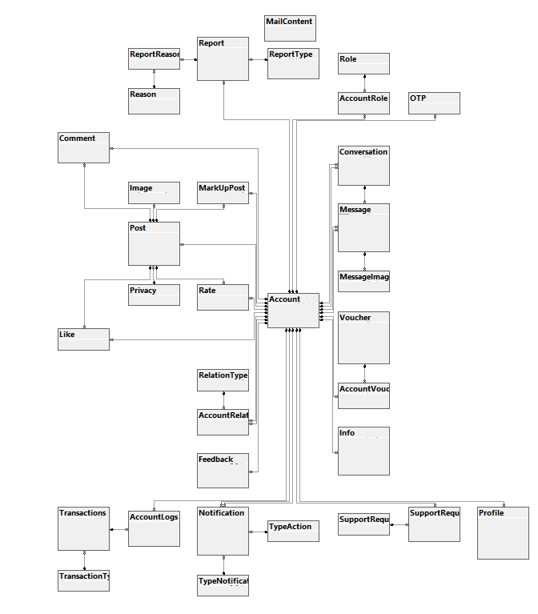
Database Design

Slide 47
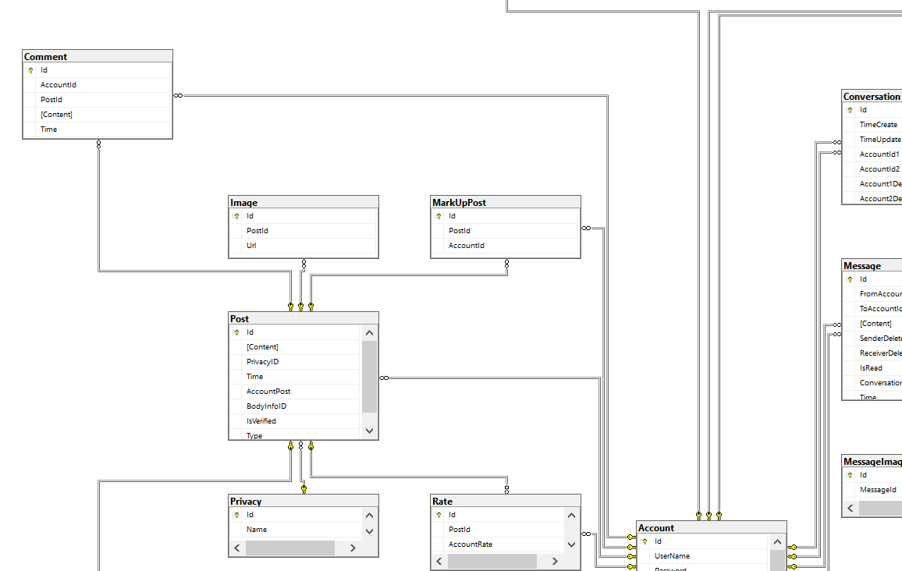
Entity relation diagram
Entity relation diagram

